Slide 1

M
a
u
r
o
P
e
r
e
i
r
a
Full-Stack Developer
< About me />
< What I did />
< What I do />
< What I’m going to do />

Slide 2
About me
First time
Back in Brazil, I developed a restaurant website and also a catering company website to update menus and last events
First course
In 2020, I started my studies and my first course it was a JavaScript course.
Bootcamp
At the end of 2022, I decided to dive 100% into my tech career and started a full-time Bootcamp Full-Stack Web Development course
First job
Next…
Never stop learning, right? Yes! Always looking forward to the next challenge and delivering results that exceed our clients’ expectations.
Yes, I did it! During the course, I got a job offer for a web developer position to work with ReactJS and AWS.

Slide 3



What I did:
< Created a user-friendly and visually appealing website for a construction company;
< Built, designed, and implemented an application to facilitate and manage appointments;
< Developed and executed an e-commerce application with a list of products, product detail, a user login, and a checkout cart.

Slide 4

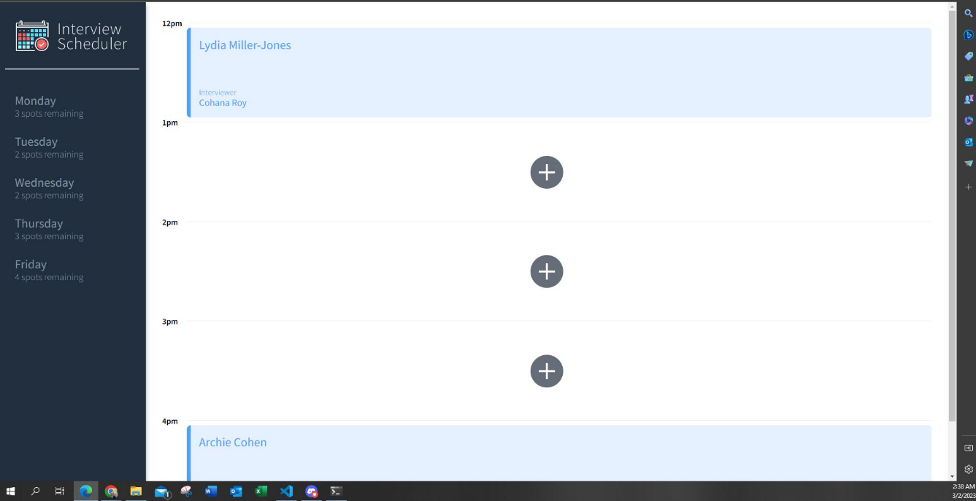
Agenda-scheduler
What I did:
Technical environment:
ReactJS, PostgreSQL, Storybook, Jest, Cypress, and WebSocket API

Slide 5
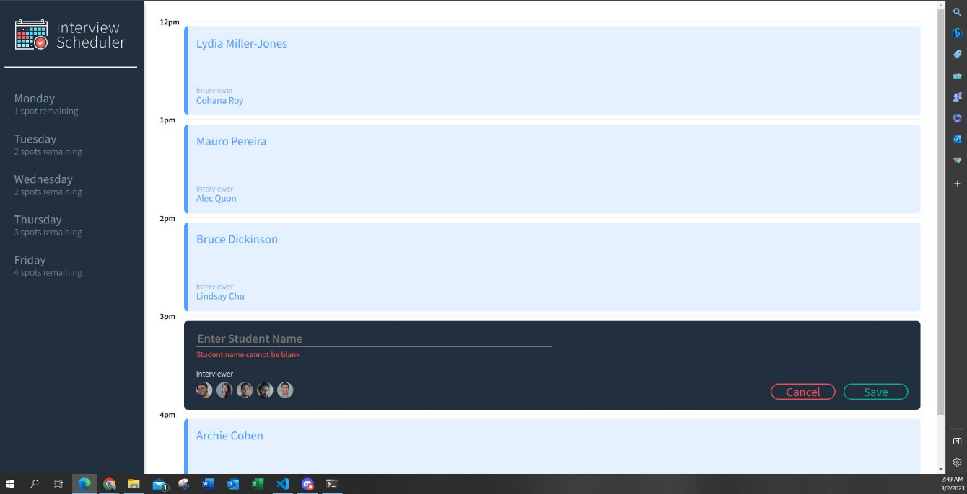
Agenda-scheduler
What I did:
Technical environment:
ReactJS, PostgreSQL, Storybook, Jest, Cypress, and WebSocket API

Slide 6
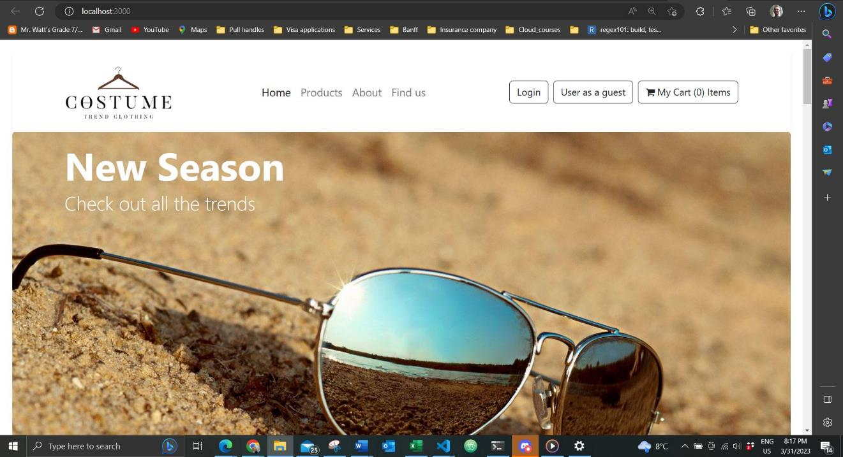
E-commerce website
What I did:
Technical environment:
ReactJS, NodeJS, Express, Auth0, and Bootstrap

Slide 7
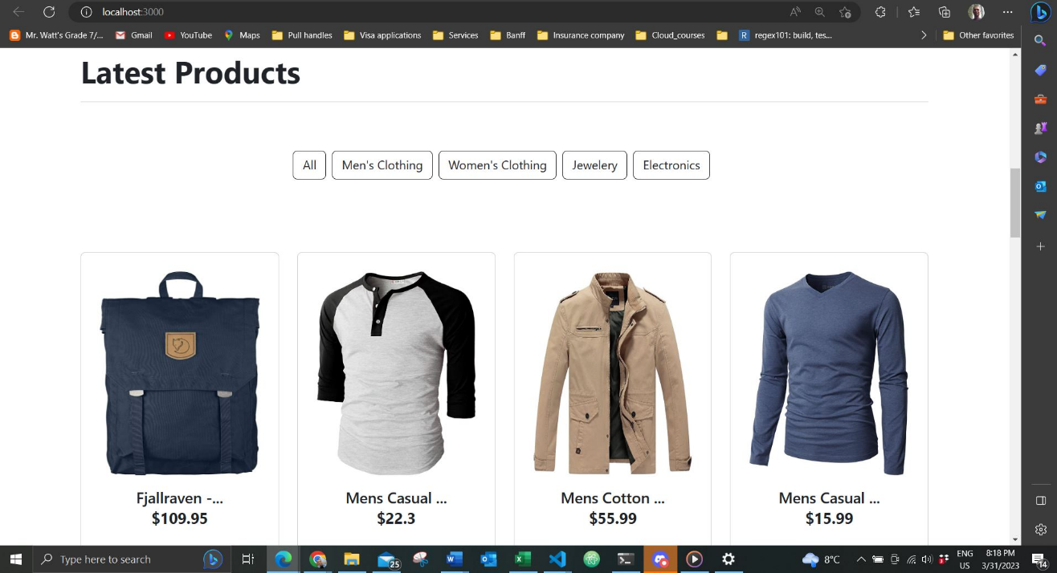
E-commerce website
What I did:
Technical environment:
ReactJS, NodeJS, Express, Auth0, and Bootstrap

Slide 8
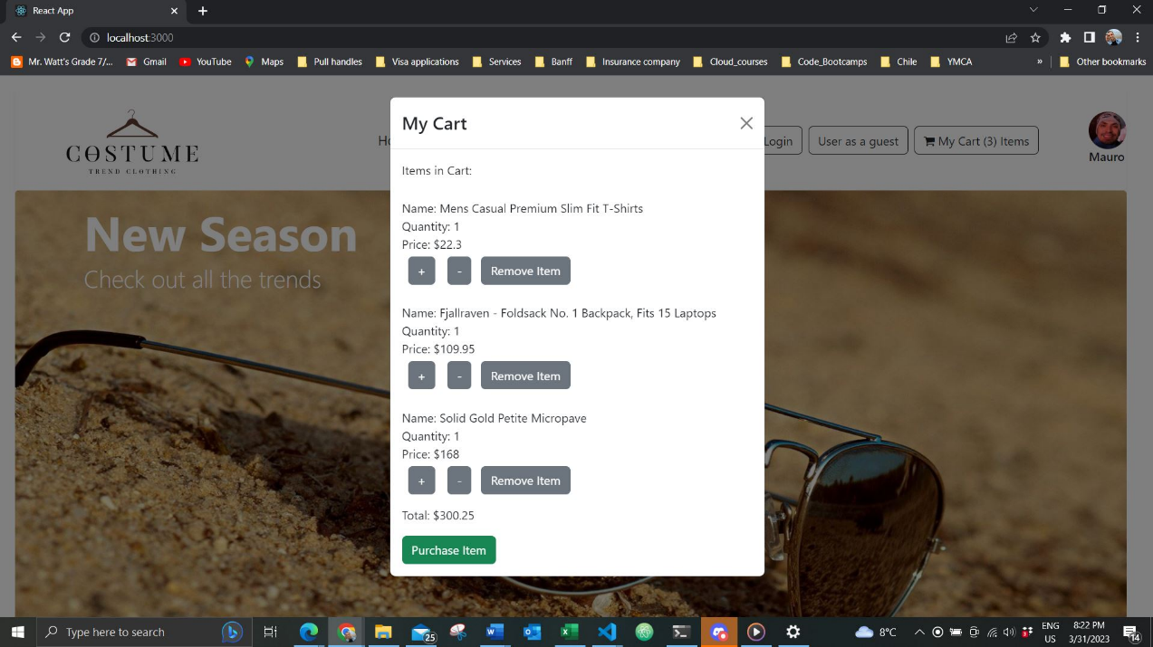
E-commerce website
What I did:
Technical environment:
ReactJS, NodeJS, Express, Auth0, and Bootstrap

Slide 9
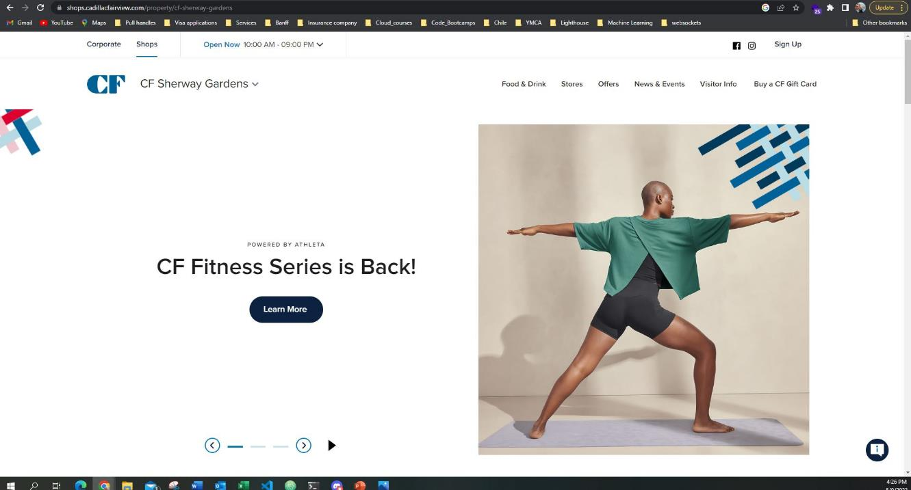
Promotional Banner
What I do:
Technical environment:
Contentful, ReactJS, NodeJS, and Ajax

Slide 10
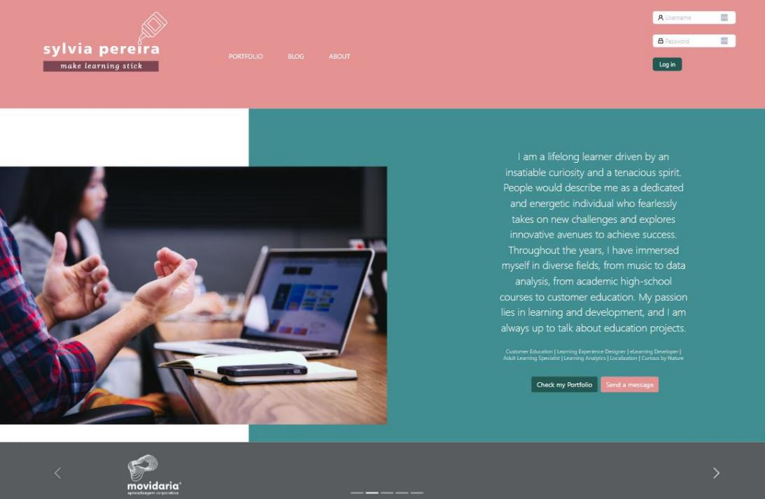
Project in progress:
What I do:
Technical environment:
ReactJS, React-DOM, React-quill, NodeJS, SQlite3, Express, Bootstrap and Jest

Slide 11




What I’m going to do:
< AWS Certification
< Another project using Contentful, GraphiQL, Gatsby and Terraform
< Learn TypeScript

Slide 12

Thank You
Mauro Pereira
< mauroapjrr@gmail.com />
< Mauro Pereira | LinkedIn />
< https://github.com/mauroapjr />

